Slide 1



Object Communication & Events
Java OOP
Advanced
SoftUni Team
Technical Trainers
Software University
http://softuni.bg

Slide 2

Table of Contents
Object Communication
Events & Event Listeners

Slide 3
Questions
sli.do #6460

Slide 4

Communication

Slide 5

Coupling

Slide 6
Coupling
Avoid tight coupling
Notes:
In software engineering, coupling is the manner and degree of interdependence between software modules; a measure of how closely connected two routines or modules are; the strength of the relationships between modules.
Coupling is usually contrasted with cohesion. Low coupling often correlates with high cohesion, and vice versa. Low coupling is often a sign of a well-structured computer system and a good design, and when combined with high cohesion, supports the general goals of high readability and maintainability.

Slide 7
Bad Example - Method Call
public class Traveler { Opel car = new Opel();
public void startJourney() {
car.move();
} }
public class Opel {
public void move() {
//logic
} }
Notes:
This is the simplest type of communication between two objects, but is also the way which resultс in the highest coupling. Traveler class has a dependency upon Opel’s class. Whenever you try to take(use) object of Traveler type, class Opel comes with it.

Slide 8

Demo

Slide 9
Decoupling
Decouple the caller of the callee
Notes:
Here the caller declares an interface and calls a method on that interface. The callee class implements that interface. That way the caller class has no dependency on the callee class. However, we need to find a way that is going to create an instance of the callee class and introduce it to the caller, so a method call can be performed. This way we create a need for intermediate class which has a dependency upon the callee class.

Slide 10
Example - Decouple
public class Traveler { Vehicle car;
public Traveler(Vehicle car) {
this.car = car;
}
//Rest of the logic }
public class Opel implements Vehicle {
public void move() {
//logic
} }
interface Vehicle {
void move();
}

Slide 11
Demo

Slide 12

Design Patterns

Slide 13
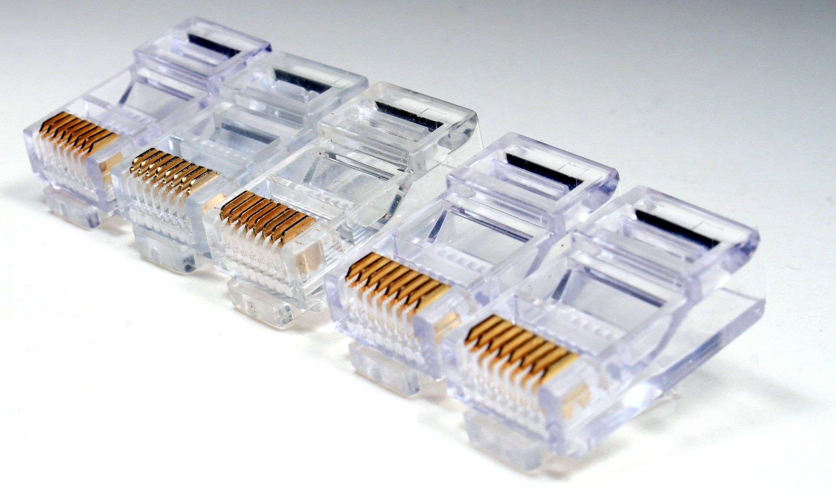
Adapter
Notes:
An even better way is when the caller declares an interface and calls a method on that interface. An adaptor class implements the interface and wraps the callee object and forwards the calls to it. This frees up the callee class from being dependent on the caller class.

Slide 14
Example - Adapter
interface MediaPlayer { void play(String audioType, String fileName); } interface AdvancedMediaPlayer { void playVlc(String fileName); void playMp4(String fileName); }

Slide 15
Example – Adapter (2)
class VlcPlayer implements AdvancedMediaPlayer{ //Logic } class Mp4Player implements AdvancedMediaPlayer{ //Logic }

Slide 16
Example – Adapter (3)
class MediaAdapter implements MediaPlayer { //Logic } public class AudioPlayer implements MediaPlayer { //Logic }

Slide 17
Example – Adapter (4)
public static void main(String[] args) { AudioPlayer audioPlayer = new AudioPlayer(); audioPlayer.play("mp3", "Bring me the horizon.mp3"); audioPlayer.play("mp4", "alone.mp4"); audioPlayer.play("vlc", "far far away.vlc"); audioPlayer.play("avi", "Beatles.avi"); }

Slide 18
Demo

Slide 19

Dependency Injection
Notes:
Dependency Injection is a software design pattern that implements inversion of control for resolving dependencies. A dependency is an object that can be used (a service). An injection is the passing of a dependency to a dependent object (a client) that would use it. There are three types of DI: constructor injection, setter injection and parameter injection.

Slide 20
Example - DI
class EmailServiceWrapper { private EmailService email = null; public EmailServiceWrapper(EmailService svc){ this.email=svc; } public void processMessages(String msg, String rec){ this.email.sendEmail(msg, rec); } }

Slide 21
Demo

Slide 22
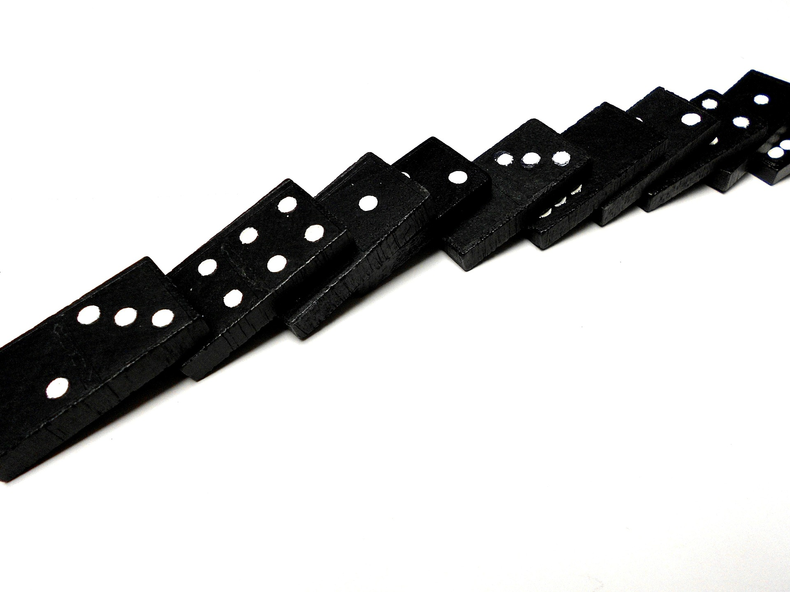
Chain of Responsibilities
Notes:
This patter is used to allow the caller to say “does anyone know how to handle this call?”. This design pattern consist of a source of command objects and a series of processing objects. Each processing object contains logic that defines the types of command objects that it can handle. The rest are passed to the next processing object in the chain. A mechanism also exists for adding new processing objects to the end of this chain.

Slide 23
Example
interface Employee { void setSuccessor(Employee successor); void processRequest(LoanRequest request); }
class BankEmployee implements Employee { @Override public void setSuccessor(Employee successor) {} @Override public void processRequest(LoanRequest request) {}

Slide 24
Example (2)
class LoanRequest { public LoanRequest(double amount, String purpose) { } }
public static void main(String[] args) { Manager manager = new Manager(); Director director = new Director(); VicePresident vp = new VicePresident(); manager.setSuccessor(director); director.setSuccessor(vp);
manager.processRequest(new LoanRequest(amount, purpose)); }

Slide 25
Demo

Slide 26

Events
Notes:
There is no such thing as an event in Java. An event keyword does not exists. We are essentially faking events and event handling by using a standard set of naming conventions and fully utilizing object-oriented programming.
The Event holds all of the information necessary for a listener to figure out what happened.

Slide 27
Events
Events and Event Listeners
Notes:
There is no such thing as an event in Java. An event keyword does not exists. We are essentially faking events and event handling by using a standard set of naming conventions and fully utilizing object-oriented programming.
The Event holds all of the information necessary for a listener to figure out what happened.

Slide 28
Example - Events
class SpeedEvent extends java.util.EventObject { public SpeedEvent(Object source, int maxSpeed, int currentSpeed) { super(source); } } interface SpeedListener extends java.util.EventListener { void handlerMethod(SpeedEvent e); }

Slide 29
Demo

Slide 30

Observer Pattern
Notes:
The observer pattern is a software design pattern in which an object, called the subject, maintains a list of its dependents, called observers, and notifies them automatically of any state changes, usually by calling one of their methods. The observer pattern can cause memory leaks, known as the lapsed listener problem, because in basic implementation it requires both explicit registration and explicit deregistration, as in the dispose pattern, because the subject holds strong references to the observers, keeping them alive. This can be prevented by the subject holding weak references to the observers.

Slide 31
Example
class EventSource extends Observable implements Runnable { public void run() { while (true) { String response = new Scanner(System.in).next(); setChanged(); notifyObservers(response); } } }

Slide 32
Example (2)
public static void main(String[] args) throws IOException { System.out.print("Enter Text: "); EventSource eventSource = new EventSource(); eventSource.addObserver(new Observer() { public void update(Observable obj, Object a) { System.out.println("Received response: " + a); } }); new Thread(eventSource).start(); }

Slide 33
Demo

Slide 34

Summary
Communication between objects
Design Patterns
Events
Event
Event Listener
Observer Pattern

Slide 35








OOP Advanced – Object Communication & Events
httpshttps://softuni.bg/courses/oop/

Slide 36

License
This course (slides, examples, demos, videos, homework, etc.) is licensed under the "Creative Commons Attribution-NonCommercial-ShareAlike 4.0 International" license
Attribution: this work may contain portions from
"Fundamentals of Computer Programming with Java" book by Svetlin Nakov & Co. under CC-BY-SA license
" Thinking in Java 4th ed." book by Bruce Eckel, Copyright © 2006 by Bruce Eckel
"OOP" course by Telerik Academy under CC-BY-NC-SA license

Slide 37






Free Trainings @ Software University
Software University Foundation – softuni.org
Software University – High-Quality Education, Profession and Job for Software Developers
softuni.bg
Software University @ Facebook
facebook.com/SoftwareUniversity
Software University @ YouTube
youtube.com/SoftwareUniversity
Software University Forums – forum.softuni.bg

